Slide 1

NETAJI SUBHAS UNIVERSITY OF TECHNOLOGY Azad Hind Fauj Marg, Sector-3, Dwarka, New Delhi - 110078
Adaptive Q-Learning VANET Routing with Dynamic Group Formation
Under the supervision of
Dr. Poonam Rani
DEPARTMENT OF COMPUTER SCIENCE AND ENGINEERING
NAME OF THE STUDENT ROLL NUMBER
Hridyesh Kumar 2021UCM2346
Sumit Rawat 2021UCM2370
Mridul Singla 2021UCM2830

Slide 2
TABLE OF CONTENT
Introduction
Motivation
Literature Survey
Problem Statement
Objective
Simulation Platform and Requirements
Conclusion
References

Slide 3
INTRODUCTION
Smart transportation today depends on a continuous, real‑time dialogue among vehicles, roadside units, and cloud‑edge servers. This dialogue is carried by Vehicular Ad Hoc Networks (VANETs), self‑organising meshes that let cars exchange millisecond‑level safety beacons, high‑definition sensor data, and dynamic map updates while they move. The wireless fabric is underpinned by dedicated standards—IEEE 802.11p (ITS‑G5) and 3GPP C‑V2X / 5 G NR‑V2X—operating in the 75 MHz band at 5.9 GHz reserved by the US FCC for V2V and V2I links. Yet routing across this fabric remains a bottleneck: urban topologies change every few seconds and the edge servers embedded in modern RSUs suffer unpredictable compute queues. Static routes or pre‑defined RSU clusters cannot keep pace, leading to latency spikes and lost safety packets. Our research tackles this gap by designing an adaptive, reinforcement‑learning‑driven routing framework that reshapes RSU groups on the fly and steers traffic around both wireless congestion and overloaded edge resources.

Slide 4
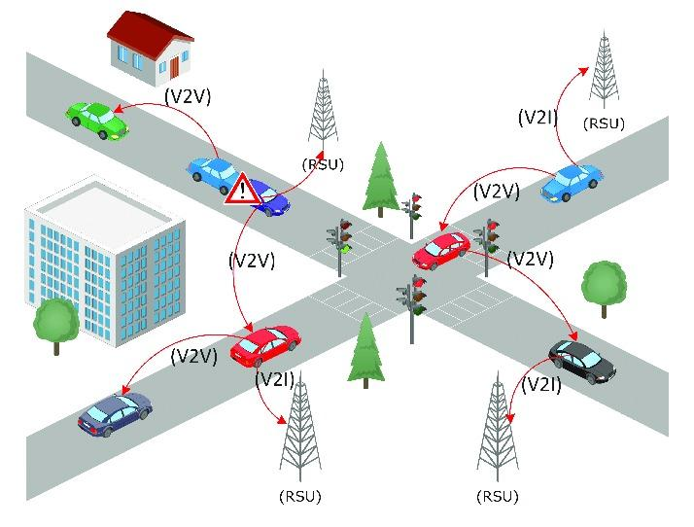
CONTINUED…
Traditional VANET routing protocols were either proactive or reactive, but recent advances now focus on hybrid protocols that blend the strengths of both. Machine learning integration into these protocols enhances the decision-making by analyzing real-time data from vehicles and infrastructure. This helps predict congestion, optimize routes, and provide early warnings for potential accidents, while also detecting driving patterns to improve vehicle coordination and prevent collisions.
Fig. A simple representation of VANET Architecture

Slide 5
MOTIVATION
Despite rapid advances in connected‑vehicle technology, road travel still claims more than a million lives each year; WHO’s 2023 report ranks traffic injuries as the world’s leading killer of 5‑ to 29‑year‑olds and projects that the global vehicle fleet will double by 2030. Human factors—speeding, late reaction, and distracted or impaired driving—remain dominant causes, yet today’s VANET routing protocols are themselves brittle: they rely on static roadside clusters fixed during deployment and optimise only the wireless path, ignoring the compute bottlenecks that now dominate latency at edge servers. When rush‑hour congestion shifts, a parade reroutes traffic, or a stadium fills and overloads nearby GPUs, safety messages and sensor off‑loads can stall for hundreds of milliseconds—precisely when real‑time response is most critical. These twin gaps—static hierarchy and compute‑blind routing—motivate our work: an adaptive, reinforcement‑learning framework that reshapes RSU groups in real time and steers packets toward both clear radio links and lightly loaded edge nodes, bringing us closer to the vision of crash‑free, congestion‑aware smart mobility

Slide 6
VANETs
Vehicular Ad Hoc Networks (VANETs) constitute a fundamental component of Intelligent Transportation Systems (ITS) within the broader smart mobility framework. These systems leverage automation and real-time data collection [55] through vehicle-to-everything (V2X) communication to enhance traffic management, reduce congestion, and improve road safety. Unlike human operators, smart transportation systems process information continuously, minimizing accidents caused by human error while ensuring smoother journeys

Slide 7
Architecture of VANETs
The VANET architecture primarily consists of Nodes, On-Board Units (OBUs), and Roadside Units (RSUs). Nodes include all communication-capable entities such as vehicles and infrastructure.
OBUs, installed in vehicles, collect and transmit driving data via Vehicle-to-Vehicle (V2V) or Vehicle-to-Infrastructure (V2I) communication.
RSUs are stationary units like traffic lights or signs that facilitate communication with vehicles and connect to broader networks like traffic management systems or the internet.
A modern Vehicular Ad Hoc Network (VANET) is more than “cars talking to each other.” It is a multi‑tier, cyber‑physical system that couples wireless links, edge‑computing boxes, cloud services, and a specialised protocol stack designed under the IEEE ITS and 3GPP C‑V2X families.

Slide 8
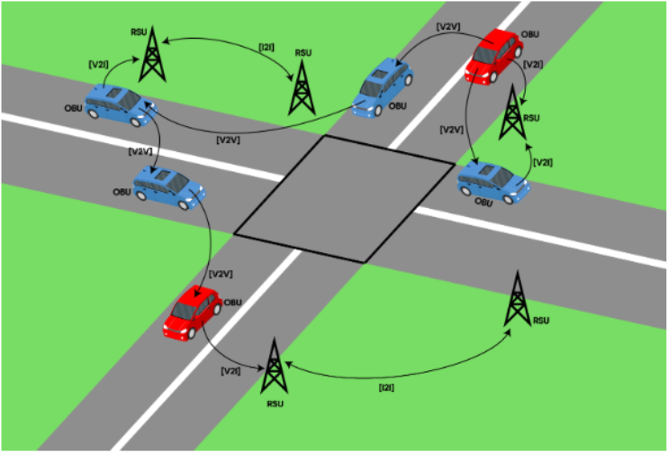
Architecture of VANETs
Fig. A simple representation of VANET Architecture with OBUs and RSUs and also showing V2V, V2I, and I2I communication among nodes.

Slide 9
Logical communication modes
In a fully fledged VANET the flow of information is organised around five logical communication modes, each serving a distinct purpose. Vehicle‑to‑Vehicle (V2V) links let neighbouring cars broadcast millisecond‑grade safety beacons and platooning commands directly, without relying on roadside infrastructure. Vehicle‑to‑Infrastructure (V2I) extends that reach to fixed Road‑Side Units (RSUs), enabling vehicles to receive signal‑phase timing, road‑hazard messages and edge‑compute services such as real‑time object recognition. When data must leave the local mesh altogether, Vehicle‑to‑Network (V2N) paths route traffic through cellular base‑stations to cloud back‑ends for map downloads, software updates, or long‑horizon analytics.

Slide 10
Logical communication modes (contd.)
Vehicle‑to‑Pedestrian (V2P) complements these channels by warning vulnerable road users—via smartphones or wearables—of imminent collisions. Finally, Infrastructure‑to‑Infrastructure (I2I) traffic stitches RSUs together into a control and aggregation backbone, distributing cluster‑formation beacons, global routing updates, and fused sensor data across the city. Together, these five modes create a layered, resilient communication fabric that underpins all higher‑level intelligent‑transport functions.

Slide 11
Machine Learning in Routing in VANETs
Machine‑learning (ML) techniques give VANETs the capacity to digest large, fast‑changing streams of mobility and channel data, anticipate congestion, and choose routes before humans—or classical heuristics—can react. For the adaptive, compute‑aware routing problem tackled in this report, ML is valuable in three complementary ways:
Predictive insight: models trained on historical traces forecast link stability and RSU load, turning a reactive protocol into a proactive one;
Structure discovery: unsupervised methods uncover ad‑hoc clusters of vehicles and RSUs, supplying the logical “groups” used by hierarchical routing;

Slide 12
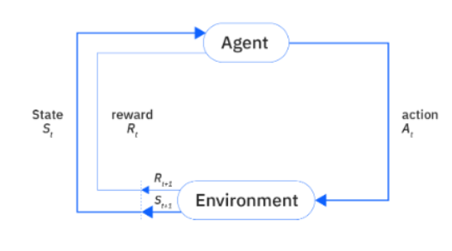
Reinforcement Learning in VANETs
Reinforcement Learning (RL) has emerged as a powerful paradigm for decision- making in dynamic and uncertain environments. Reinforcement learning (RL) is a machine learning technique that teaches machines to make decisions through trial and error.
Online adaptation: reinforcement learning (RL) refines decisions on the fly, eliminating the need for pre‑labelled data and coping with never‑seen traffic events.
Fig. Decision Making in Reinforcement Learning

Slide 13
Reinforcement Learning in VANETS
Reinforcement Learning in VANETs Reinforcement learning (RL) has quickly become the most promising intelligence layer for Vehicular Ad Hoc Networks because it learns policies directly from interaction, without pre‑labelled data, and can adapt online to non‑stationary traffic patterns. In a typical VANET formulation, an agent—hosted on each vehicle or roadside unit—observes a state vector that can include neighbour RSSI, link queue length, vehicle density, and even edge‑server CPU utilisation; it then selects an action such as the next‑hop node, the forwarding rate, or the execution RSU for off‑loaded tasks. Classical tabular Q‑learning variants (e.g., IQRRL, PbQR) have already demonstrated double‑digit gains in delivery ratio by predicting future link breaks, while hierarchical extensions like HQGR reduce broadcast overhead by separating inter‑group from intra‑group decision‑making.

Slide 14
Reinforcement Learning in VANETS
More recent deep‑RL approaches—DQN, A3C, and PPO—replace tables with neural networks, enabling scaling from tens to hundreds of RSUs and vehicles. Emerging research also folds edge‑compute metrics into the reward so routes avoid overloaded GPUs, and uses multi‑objective RL to let operators dial delay versus energy on the fly. Taken together, these advances position RL as the de‑facto framework for real‑time, self‑optimising routing in the highly dynamic, heterogeneous environment of future smart‑city VANET deployments.
The Hierarchical Q- learning-based Routing Algorithm with Grouped RSU (HQGR). The approach proposed was to divide the urban areas into groups based on the position of the RSUs and then use a multi-agent hierarchical Q-learning model to train a group Q-table and a local Q-table. The agent aims to maximize the cumulative reward for both the group and the local table by reaching the destination group and subsequently finding the best path within the group to reach the target, respectively.

Slide 15
CONCLUSION
Reinforcement learning transforms VANET routing from a static, rule‑based procedure into a self‑optimising, context‑aware service that continuously learns from the road itself. By framing routing as a Markov‑Decision Process, RL agents can anticipate link failures, balance loads on edge servers, and reconfigure paths in milliseconds—capabilities conventional protocols cannot match. Tabular Q‑learning has proven the concept; deep and hierarchical variants now scale it to full smart‑city deployments. Remaining challenges—state‑space explosion, real‑world validation, and lightweight inference—are already being addressed through dynamic clustering, transfer learning, and efficient model compression. As these techniques mature, RL‑driven VANETs will move from simulation labs to urban streets, closing the gap between the vision of zero‑collision transportation and today’s safety‑critical reality.

Slide 16
REFERENCES
[1] (2021). Use of the 5.850-5.925 ghz band.https://www.federalregister.gov/documents/2021/05/03/2021-08802/use-of-the-5850-5925-ghz-band.
[2] Al-Sultan, S., Al-Doori, M. M., Al-Bayatti, A. H., and Zedan, H. (2014). A comprehensive survey on vehicular ad hoc network. Journal of Network and Computer Applications, 37:380–392.
[3] Ardakani, S. (2018). Acr: a cluster-based routing protocol for vanet. International Journal of Wireless Mobile Networks, 10:15.
[4] Bitam, S., Mellouk, A., and Zeadally, S. (2013). Hybr: A hybrid bio-inspired bee swarm routing protocol for safety applications in vehicular ad hoc networks (vanets). Journal of Systems Architecture, 59(10, Part B):953–967. Advanced Smart Vehicular Communication System and Applications.
[5] C´ardenas, L. L., Mezher, A. M., Barbecho Bautista, P. A., Astudillo Le´on, J. P., and Igartua, M. A. (2021). A multimetric predictive ann-based routing protocol for vehicular ad hoc networks. IEEE Access, 9:86037–86053.
[6] Dutta, A., Campoverde, L. M. S., Tropea, M., and Rango, F. D. (2024). A comprehensive review of recent developments in vanet for traffic, safety & remote monitoring applications. J. Netw. Syst. Manag., 32:73.
[7] Dutta, R. and Thalore, R. (2017). A review of various routing protocols in vanet. International Journal of Advanced Engineering Research and Science, 4:221–224.
[8] Erman, J., Arlitt, M., and Mahanti, A. (2006). Traffic classification using clustering algorithms. volume 2006, pages 281–286.
[9] Habib, M. A., Khan, M., and Uddin, J. (2016). Optimal route selection in complex multi-stage supply chain networks using sarsa().
[10] Hartenstein, H. and Laberteaux, K. P. (2008). A tutorial survey on vehicular ad hoc networks. IEEE Communications Magazine, 46.
[11] Hussein, N. H., Yaw, C. T., Koh, S. P., Tiong, S. K., and Chong, K. H. (2022). A comprehensive survey on vehicular networking: Communications, applications, challenges, and upcoming research directions. IEEE Access, 10:86127–86180.
[12] Jabbar, W., Malaney, R., and Yan, S. (2020). A location verification based hybrid routing protocol for vanets. In 2020 IEEE 92nd Vehicular Technology Conference (VTC2020-Fall), pages 1–6.
[13] Jiang, D. and Delgrossi, L. (2008). Ieee 802.11p: Towards an international standard for wireless access in vehicular environments. In VTC Spring 2008- IEEE Vehicular Technology Conference, pages 2036–2040.
[14] John Schulman, Filip Wolski, P. D. A. R. O. K. (2017). Proximal policy optimization algorithms.
[15] K, T., T M, S., M, B., and K H, A. (2015). A survey on vanet technologies. Int. J. Comput. Appl., 121(18):1–9.
[16] Kakarla, J., Sathya, S. S., Laxmi, B., and Babu, B. (2011). A survey on routing protocols and its issues in vanet. International Journal of Computer Applications, 28. 20(1):383–398.

Slide 17
REFERENCES
[17] Karp, B. and Kung, H. T. (2000). Gpsr: greedy perimeter stateless routing for wireless networks. In Proceedings of the 6th Annual International Conference on Mobile Computing and Networking, MobiCom ’00, page 243–254, New York, NY, USA. Association for Computing Machinery.
[18] Lee, D., Tak, S., and Kim, S. (2022). Development of reinforcement learning-based traffic predictive route guidance algorithm under uncertain traffic environment. IEEE Access, 10:58623–58634.
[19] Liang, W., Li, Z., Zhang, H., Wang, S., and Bie, R. (2015). Vehicular ad-hoc networks: Architectures, research issues, methodologies, challenges, and trends. International Journal of Distributed Sensor Networks, 2015:1–11.
[20] Lim, K. H. and Datta, A. (2012). Enhancing the tora protocol using net-work localization and selective node participation. In 2012 IEEE 23rd International Symposium on Personal, Indoor and Mobile Radio Communications- (PIMRC), pages 1503–1508.
[21] Lu, T., Schuurmans, D., and Boutilier, C. (2018). Non-delusional q-learning and value-iteration. In Bengio, S., Wallach, H., Larochelle, H., Grauman, K., Cesa-Bianchi, N., and Garnett, R., editors, Advances in Neural Information Processing Systems, volume 31. Curran Associates, Inc.
[22] Luo, L., Sheng, L., Yu, H., and Sun, G. (2022). Intersection-based v2x routing via reinforcement learning in vehicular ad hoc networks. IEEE Transactions on Intelligent Transportation Systems, 23(6):5446–5459.
[23] Lusvarghi, L. and Merani, M. L. (2022). Machine learning for disseminating cooperative awareness messages in cellular v2v communications. IEEE Transactions on Vehicular Technology, 71(7):7890–7903.
[24] Marwah, G. P. K. and Jain, A. (2022). A hybrid optimization with ensemble learning to ensure VANET network stability based on performance analysis. Sci. Rep., 12(1):10287.
[25] Mazur, S. (2020). An introduction to smart transportation: Benefits and examples. https://www.digi.com/blog/post/introduction-to-smart- transportation-benefits.
[26] M´endez, M., Merayo, M. G., and N´u˜nez, M. (2023). Long-term traffic flow forecasting using a hybrid CNN-BiLSTM model. Eng. Appl. Artif. Intell., 121(106041):106041.
[27] MohanSharma, Y. and Mukherjee, S. (2012). A contemporary proportional exploration of numerous routing protocols in vanet. International Journal of Computer Applications, 50:14–21.
[28] Naeem, M., Rizvi, S., and Coronato, A. (2020). A gentle introduction to reinforcement learning and its application in different fields. IEEE Access, 8:209320–209344.
[29] Nazib, R. A. and Moh, S. (2021). Reinforcement learning-based routing protocols for vehicular ad hoc networks: A comparative survey. IEEE Access, 9:27552–27587.A Survey Article on Reinforcement Learning in VANETs 13

